Slide 1
CS 380
Introduction to Database Systems
(Chapter 3: Data Modeling Using the Entity-Relationship Model)

Slide 2
Outline
Main Phases of Database Design
Example (Company Example)
Entities and Attributes
Key Attribute(s)
Value Sets (Domain) of Attributes
Relationships
Constraints on Relationship Types (Structural Constraints)
Attributes for Relationship Types
Weak Entity Type
Summary of ER-Diagram Notation
Alternative Notations for ER Diagrams
Reading: Chapter 3
Chapter 3: Data Modeling Using the Entity-Relationship Model
1

Slide 3
Main Phases of Database Design
1st Step : Requirements collection and analysis:
  Designers interview users to understand and document their
  data requirements as a set of detailed user requirements
  In parallel, it is useful to specify the known functional
  requirements of the application, which consists of user defined operations ( updates and retrievals) that will be applied to the database.
Chapter 3: Data Modeling Using the Entity-Relationship Model
2

Slide 4
Main Phases of Database Design
2nd Step : Creating a conceptual schema for the database using high-level conceptual data model:
  This step is called conceptual database design.
  Conceptual schema is a concise high level description of user
  data requirements including description of entity types,
  relationships and constraints.
  ER model is used.
  Does not include implementation details.
  Users and developers can easily understand and discuss
  Used to ensure all user requirements are met.
  Enables designers to concentrate on specifying the properties of the data, without being concerned about storage details.
Chapter 3: Data Modeling Using the Entity-Relationship Model
3

Slide 5
Main Phases of Database Design
3rd Step: Specifying the high-level user operations:
  During or after the conceptual schema design, the basic data
  model operations can be used to specify the high-level user
  operations identified during functional analysis.
  Serves to confirm that the conceptual schema can meet all the identified functional requirement.
Chapter 3: Data Modeling Using the Entity-Relationship Model
3

Slide 6
Main Phases of Database Design
4th Step : Actual implementation of the database using DBMS:
  This step is called logical design or data model mapping and its
  result is a database schema in the implementation data model of
  the DBMS. In other words, conceptual schema is transformed from the high level data model (ER model) into implementation data model (relational model).
5th Step : Schema Refinement:
  This step analyses the collection of relational database schema to identify potential problems and to refine it. We use the theory normalizing relations i.e. restructuring them to ensure some desirable properties.
Chapter 3: Data Modeling Using the Entity-Relationship Model
4

Slide 7
Main Phases of Database Design
6th Step: Physical database design phase:
  The internal storage structures, indexes, access paths and file
  organizations for the database files are specified.
7th step: Application and Security Design:
In parallel with these activities, application programs are
designed and implemented. At the same time ensure security measures on the access of database.
Chapter 3: Data Modeling Using the Entity-Relationship Model
4

Slide 8
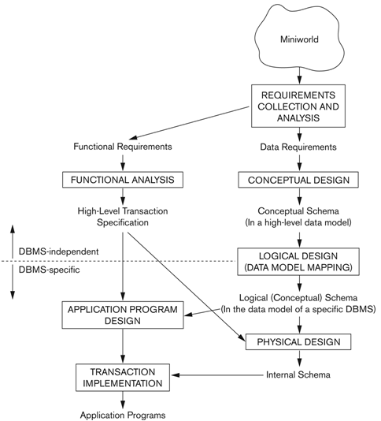
Main Phases of Database Design
Chapter 3: Data Modeling Using the Entity-Relationship Model
5

Slide 9
Example (Company)
The COMPANY database keeps track of a company’s employees, departments and projects.
The company is organized into departments. Each department has a unique name, a unique number, and a particular employee who
manages the department. We keep track of the start date when that
employee began managing the department. A department may have several locations.
A department controls a number of projects, each of which has a
unique name, a unique number, and a single location.
Chapter 3: Data Modeling Using the Entity-Relationship Model
6

Slide 10
Example (Company)
We store each employee’s name, social security number, address,
salary, sex, and birth date. An employee is assigned to one
department but may work on several projects, which are not
necessarily controlled by the same department. We keep track of
the number of hours per week that an employee works on each
project. We also keep track of the direct supervisor of each
employee.
We want to keep track of the dependents of each employee for
insurance purposes. We keep each dependent’s first name, sex,
birth date, and relationship to the employee.
Chapter 3: Data Modeling Using the Entity-Relationship Model
7

Slide 11
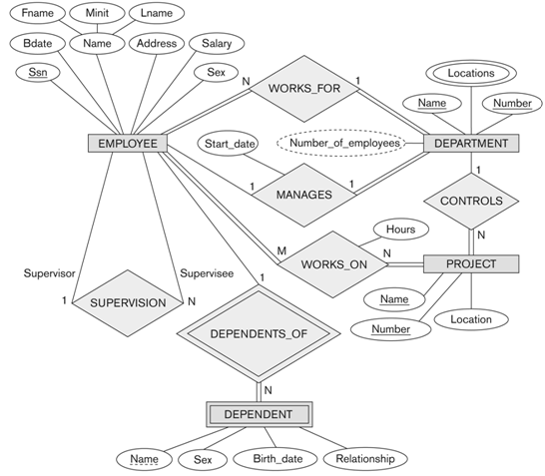
Example (Company Example)- ER Diagram
Chapter 3: Data Modeling Using the Entity-Relationship Model
8

Slide 12
Entities and Attributes
The ER Model describes data as entities, relationships and attributes.
Entity:
  The basic object that the ER model represents is an entity, which
  is a “thing” in the real world with an independent existence.
  Could be an object with a physical existence (person, car) or conceptual
  existence (company, course).
  Each entity has attributes.
Attribute:
  Property describing an entity.
  E.g. Employee name, age, salary,...etc.
PERSON
SALARY
Chapter 3: Data Modeling Using the Entity-Relationship Model
9

Slide 13
Entities with values of their attributes
An entity will have a value for each of its attributes; e.g. A specific
employee entity may have Name=‘John Smith”, ...etc.
Name = John Smith
e1
Age = 55
Salary = 30000
The attribute values that describe each entity become a part of the data stored in the database.
Chapter 3: Data Modeling Using the Entity-Relationship Model
10

Slide 14
Types of Attributes - Simple Versus Composite
Simple:
  Each entity has a single atomic value for the attribute.
  e.g. Salary.
Composite:
  Composite attribute is composed of several components, each of which represent more basic attributes with independent meaning.
  E.g. Name (FirstName, MiddleName, LastName).
  Composition may form a hierarchy where some components
  are themselves composite.
  The value of a composite attribute is the concatenation of the values of its constituent simple attributes.
FirstName
MiddleName
LastName
SALARY
Name
Chapter 3: Data Modeling Using the Entity-Relationship Model
11

Slide 15
Types of Attributes - Single-Valued Versus Multivalued
Single-valued:
  One single value for a particular entity.
  E.g. Salary.
Multi-valued:
  A set of values for the same entity.
  E.g. colours attribute for a car - {Color} or
  College degrees attribute for a person - {college degree}.
  A multi-valued attribute may have lower and upper bounds to constrain the number of values allowed for each individual entity e.g. the colors attribute of a car may have between 1 and 3 values.
SALARY
Color
Chapter 3: Data Modeling Using the Entity-Relationship Model
12

Slide 16
Types of Attributes - Stored Versus Derived
Stored:
  E.g. Birth_date.
Derived:
  When two or more attributes are related, the value of one attribute can be obtained from other.
  E.g. The age can be determined from the current date and the value of the birth date of a person, so age is a derived attribute and birth_date is a stored attribute.
  Some attribute values can be derived from related entities; e.g. an attribute Number_of_employees of a DEPARTMENT entity can be derived by counting the number of employees related to that department.
BDate
Age
Chapter 3: Data Modeling Using the Entity-Relationship Model
13

Slide 17
Types of Attributes
NULL values:
  Unknown value: a particular person has a date of birth but it is
  unknown, so it is represented by NULL in the database.
  Unavailable value: a person has a home phone but does not
  want it to be listed, so it is represented as NULL in the database.
  Not applicable attribute: an attribute CollegeDegree would be
  NULL for a person who has no college degrees.
Complex Attributes:
    Composite and multivalued attributes can be nested in an
    arbitrary way.
    E.g. {AddressPhone{(Phone(AreaCode, PhoneNumber)},
    {Address(StreetAddress(Number, Street,
    ApartmentNumber), City, State, Zip)}}
Chapter 3: Data Modeling Using the Entity-Relationship Model
14

Slide 18
Entity Types, Entity Sets
A database usually contains groups of entities that are similar.
E.g. A company storing similar information for each employee.
The employee entities share the same attributes but each entity has
its own value(s) for each attribute.
An entity type defines a collection (or set) of entities with the same
attributes.
Chapter 3: Data Modeling Using the Entity-Relationship Model
15

Slide 19
Entity Types, Entity Sets
ENTITY TYPE EMPLOYEE
Name: Name, Age, Salary
ENTITY SET:
(EXTENSION)
e1
(John Smith, 55, 30000)
e2
(Fred Brown, 40, 25000)
e3
(Judy Clark, 25, 20000)
:
:
Chapter 3: Data Modeling Using the Entity-Relationship Model
16

Slide 20
Key Attribute(s)
An important constraint on the entity of an entity type is the key or
uniqueness constraint on attributes.
An entity type usually has an attribute whose values are distinct for
each individual entity in the collection, called key attribute.
The value of the key attribute is used to identify each entity
uniquely.
SSN
Chapter 3: Data Modeling Using the Entity-Relationship Model
17

Slide 21
Key Attribute(s)
Sometimes, several attributes together form a key meaning that the
combination of the attribute values must be distinct for each entity.
In this case it is called a composite key.
FlightNo
Date
FlightID
Chapter 3: Data Modeling Using the Entity-Relationship Model
18

Slide 22
Value Sets (Domain) of attributes
The domain is the set of permitted values for each attribute.
Each simple attribute of an entity type is associated with a value
set (or domain of values) which specifies the set of values that may
be assigned to that attribute for each entity.
Chapter 3: Data Modeling Using the Entity-Relationship Model
19

Slide 23
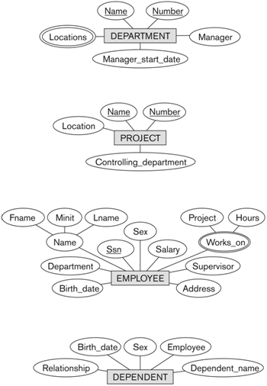
Initial Conceptual Design of the Company Example
Chapter 3: Data Modeling Using the Entity-Relationship Model
20

Slide 24
Relationships
Whenever an attribute of one entity refers to another entity type,
some relationship exists.
E.g. The attribute Manager of Department refers to an employee
who manages the department.
In ER Model these references should not be represented as
attributes but as relationships.
Chapter 3: Data Modeling Using the Entity-Relationship Model
21

Slide 25
Relationship Types, Sets, and Instances
A relationship relates two or more distinct entities with a specific
meaning.
e.g. EMPLOYEE John Smith works on the ProductX PROJECT.
Relationships of the same type are grouped or typed into a
relationship type.
E.g. The WORKS-ON relationship type in which EMPLOYEEs
and PROJECTs participate.
WORKS
-ON
Chapter 3: Data Modeling Using the Entity-Relationship Model
22

Slide 26
Relationship Types, Sets, and Instances
A relationship R among n entity types E1, E2,...En defines a set
of associations (or a relationship set) among entities from these
types.
Mathematically, the relationship set R is a set of relationship
instances ri, where each ri associates n individual entities (e1,e2...en).
Chapter 3: Data Modeling Using the Entity-Relationship Model
23

Slide 27
Relationship Degree
Degree of a relationship is the number of entity types that
participate in it:
  Unary (or recursive) relation ship.
  Binary Relationship.
  Ternary relationship.
Chapter 3: Data Modeling Using the Entity-Relationship Model
24

Slide 28
Relationship Degree - Unary relationship
EMPLOYEE
SUPERVISION
r
e
●
2
1
1
e
1
●
r
2
2
2
e
1
3
●
2
r
e
3
4
●
1
e
2
r
5
●
1
4
1
e
●
r
6
2
5
e
1
7
●
:
r
2
6
:
Chapter 3: Data Modeling Using the Entity-Relationship Model
25

Slide 29
Relationship Degree - Binary relationship
EMPLOYEE
WORKS_FOR
DEPARTMENT
r
1
e
●
●
d
1
r
1
2
e
●
2
r
e
3
d
3
●
●
2
r
e
●
4
4
e
r
●
d
5
●
5
:
3
e
●
r
6
6
e
●
r
:
7
7
:
Chapter 3: Data Modeling Using the Entity-Relationship Model
26

Slide 30
Relationship Degree - Ternary relationship
SUPPLIER
SUPPLY
PROJECT
s
r
1
●
1
●
j
s
r
1
2
●
2
:
r
j
3
●
2
r
4
PART
●
j
r
3
5
:
p
r
1
●
6
p
2
●
r
7
p
:
3
●
:
Chapter 3: Data Modeling Using the Entity-Relationship Model
27

Slide 31
Role Names and Recursive Relationships
Each entity type that participates in a relationship type plays a
particular role in the relationship.
E.g. In the WORKS-FOR relationship type, EMPLOYEE plays
the role of employee or worker and DEPARTMENT plays the role
of department or employer.
Role names are not necessary in relationships where all entities are
distinct since each entity name can be used as the role name.
However, in some cases the role names are essential for
distinguishing the meaning of participation.
Such relationship types are called unary relationships (recursive
relationships).
Chapter 3: Data Modeling Using the Entity-Relationship Model
28

Slide 32
Constraints on Relationship Types (Structural Constraints)
There are two types of relationship constraints:
  Cardinality ratio.
  Participation.
Chapter 3: Data Modeling Using the Entity-Relationship Model
29

Slide 33
Cardinality Ratio for Binary Relationships
The cardinality ratio specifies the maximum number of relationship
instances that an entity can participate in.
E.g. In the WORKS-FOR binary relationship type,
EMPLOYEE:DEPARTMENT is of cardinality N:1 meaning that
an employee can be related to only one department but each
department can be related to many employees.
The possible cardinality ratios for binary relationships are:
1:1, 1:N, N:1, M:N.
E
1
R
N
E
1
2
Chapter 3: Data Modeling Using the Entity-Relationship Model
30

Slide 34
Participation for Binary Relationships
The constraints specifies
  Whether the existence of an entity depends on its being related to another entity via the relationship type.
  the minimum number of relationship instances that each entity can participate in, and is called minimum cardinality constraint
There are two types of participation constraints:
  Total.
  Partial.
R
E
1
R
E
2
Chapter 3: Data Modeling Using the Entity-Relationship Model
31

Slide 35
Attributes of Relationship Types
Relationship types can also have attributes.
E.g. To record the number of hours per week that an employee
works on a particular project. The attribute Hours can be included
to the WORKS-ON relationship type.
Attributes of 1:1 relationship types can be migrated to one of the
participating entity types.
Attributes of 1:N or N:1 relationship types can be migrated only to
the entity type N-side of the relationship.
Attributes of M:N relationship types must be specified as
relationship attributes.
Chapter 3: Data Modeling Using the Entity-Relationship Model
32

Slide 36
Weak Entity Type
A strong entity type is an entity that have a key attribute.
(I.e. It exists independently of other entity types)
A weak entity type is an entity that does not have a key attribute.
(I.e. Its existence depend on some other entity type)
The entity type which the weak entity type depends on is called the
identifying entity type (owner).
Weak entities are identified by the combination of:
  A partial key (discriminator) of the weak entity type.
  The particular entity they are related to in the identifying entity
  type.
Chapter 3: Data Modeling Using the Entity-Relationship Model
33

Slide 37
Weak Entity Type
SSN
Salary
Name
Sex
1
N
EMPLOYEE
DEPENDENTS
-OF
DEPENDENT
BDate
Relationship
Chapter 3: Data Modeling Using the Entity-Relationship Model
34

Slide 38
ER Diagram Conventions
One should choose names that convey, as much as possible, the
meanings attached to the different constructs in the schema.
Nouns for entity type and attribute names and verbs for relationship
type names.
Choosing binary relationship names to make the ER diagram
readable from left to right and from top to bottom.
Entity type and relationship type names in uppercase letters,
attribute names capitalized, and roll names in lowercase.
Chapter 3: Data Modeling Using the Entity-Relationship Model
35

Slide 39
Summary of Notation For ER-Diagrams
Symbol
Meaning
ENTITY TYPE
WEAK ENTITY TYPE
RELATIONSHIP TYPE
IDENTIFYING RELATIONSHIP TYPE
ATTRIBUTE
KEY ATTRIBUTE
MULTIVALUED ATTRIBUTE
COMPOSITE ATTRIBUTE
DERIVED ATTRIBUTE
E
E
TOTAL PARTICIPATION OF E
IN R
1
R
2
2
E
1
R
N
E
CARDINALITY RATIO 1:N FOR E
:E
IN R
1
2
1
2
R
(min,max)
E
STRUCTURAL CONSTRAINT (min, max) ON PARTICIPATION
OF E IN R
Chapter 3: Data Modeling Using the Entity-Relationship Model
36

Slide 40
Example (Company Example)
Chapter 3: Data Modeling Using the Entity-Relationship Model
37

Slide 41
Alternative (min, max) notation for ER Diagrams
Specified on each participation of an entity type E in a relationship
type R.
Specifies that each entity e in E participates in at least min and at
most max relationship instances in R.
Default (no constraint): min = 0, max = n.
Must have 0 <= min <= max and max >= 1.
Derived from the knowledge of mini-world constraints.
Chapter 3: Data Modeling Using the Entity-Relationship Model
38

Slide 42
Alternative (min, max) notation for ER Diagrams
A department has exactly one manager and an employee can
manage at most one department:
  Specify (0,1) for participation of EMPLOYEE in MANAGES.
  Specify (1,1) for participation of DEPARTMENT in
  MANAGES.
(0,1)
(1,1)
EMPLOYEE
MANAGES
DEPARTMENT
Chapter 3: Data Modeling Using the Entity-Relationship Model
39

Slide 43
Alternative (min, max) notation for ER Diagrams
An employee can work for exactly one department but a department
can have any number of employees:
  Specify (1,1) for participation of EMPLOYEE in WORK_FOR.
  Specify (1,N) for participation of DEPARTMENT in
  WORKS_FOR.
(1,1)
(1,N)
EMPLOYEE
WORKS_FOR
DEPARTMENT
Chapter 3: Data Modeling Using the Entity-Relationship Model
40

Slide 44
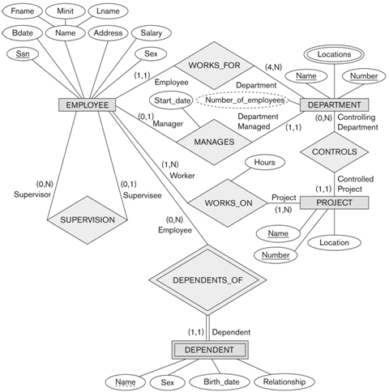
Alternative (min, max) notation for ER Diagrams
Chapter 3: Data Modeling Using the Entity-Relationship Model
41

Slide 45
Alternative Notations for ER Diagrams
ER diagrams is one popular example for displaying database
schemas.
Many other notations exist in the literature and in various database
design and modeling tools.
Appendix A illustrates some of the alternative notations that have
been used.
UML class diagrams is representative of another way of displaying
ER concepts that is used in several commercial design tools.
Chapter 3: Data Modeling Using the Entity-Relationship Model
42

Slide 46
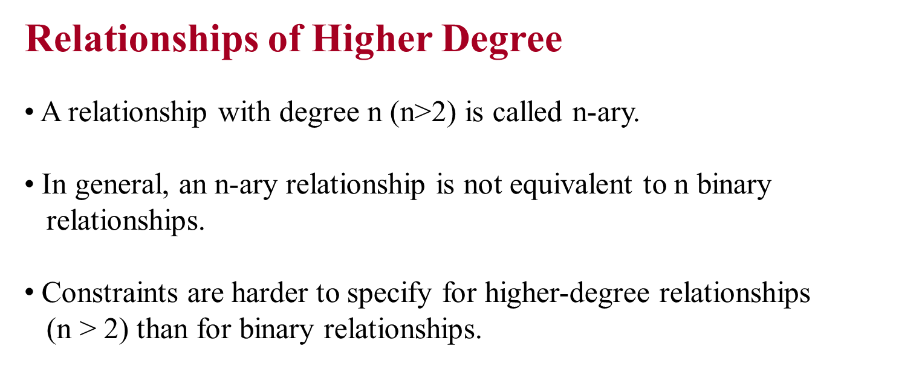
Chapter 3: Data Modeling Using the Entity-Relationship Model
43

Slide 47

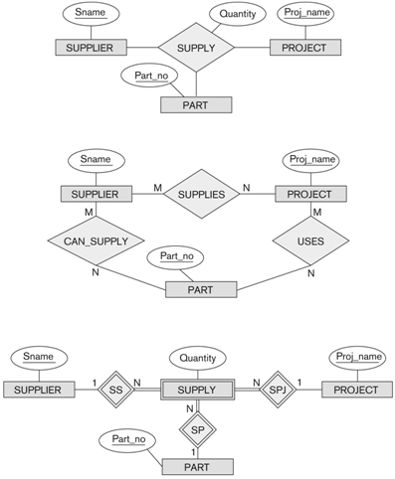
=
=
Chapter 3: Data Modeling Using the Entity-Relationship Model
44

Slide 48

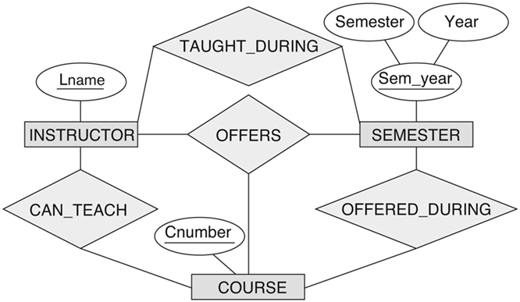
Chapter 3: Data Modeling Using the Entity-Relationship Model
45

Slide 49
Displaying Constraints on Higher-Degree Relationships
The (min, max) constraints can be displayed on the edges. However,
they do not fully describe the constraints.
Displaying a 1, M, or N indicates additional constraints:
  An M or N indicates no constraint.
  A 1 indicates that an entity can participate in at most one
  relationship instance that has a particular combination of the
  other participating entities.
In general, both (min, max) and 1, M, or N are needed to describe
fully the constraints.
Chapter 3: Data Modeling Using the Entity-Relationship Model
46

